Slide 1

Data
Domains of AI
Organized by Habib Matar
in collaboration with Intel.

Slide 2
What do we have over the ancient philosophers and scientists of old?

Slide 3
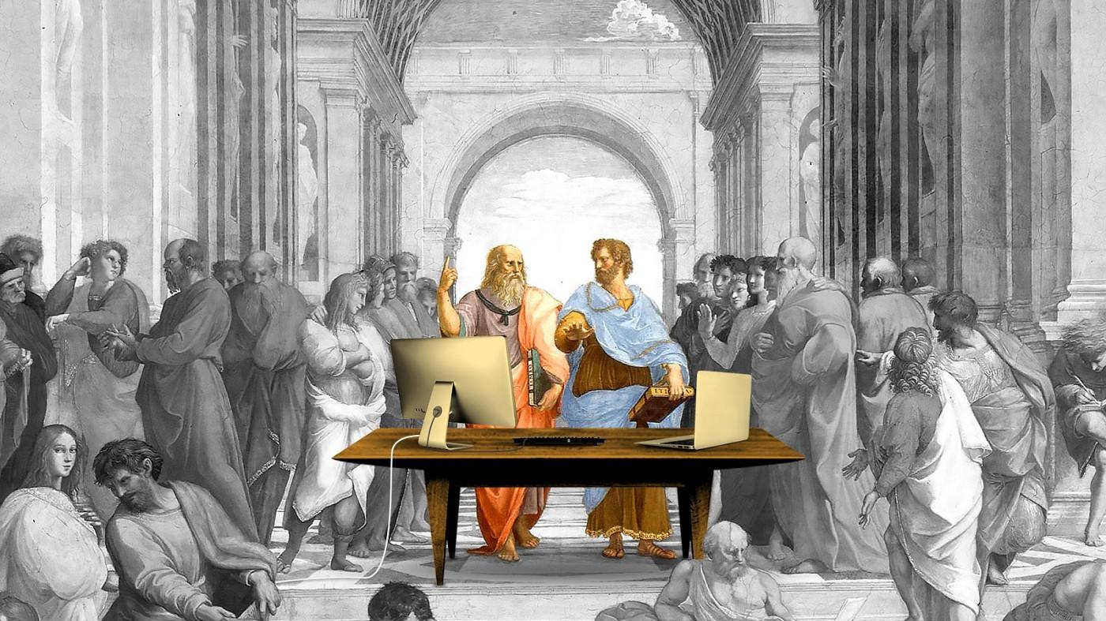

Slide 4
Data is the Fuel of AI
Data can come from many different sources. Here is just a sampling:
Web/social (Facebook, Twitter, Instagram, You Tube)
Biometric Data (fitness, trackers, genetics tests)
Internet of Things or IoT (ID tags and smart devices)
Cloud systems (business applications like salesforce.com or Amazon)
Corporate databases and Spreadsheets.

Slide 5
Types of Data
There are two ways to organize data.
1. Structured Data:
Financial Information
Social Security numbers
Addresses
Product information
Phone numbers
For most part, structured data is easier to work with. This data often comes from Customer Relationship Management and usually has lower volume and they are straightforward. This type counts to about 20% of an AI project.

Slide 6
Types of Data
There are two ways to organize data.
The majority of the data comes from unstructured data, which is information that has no predefined formatting.
2. Examples of Unstructured Data:
Images
Audio files
Text files
Tweets and posts
Satellite images

Slide 7
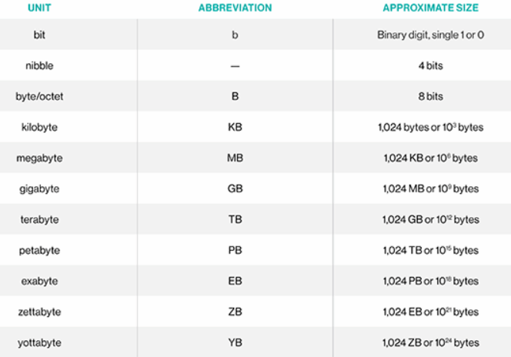
Types of Data Levels
Value | Use Case
MB = 1,000 Kilobytes | A Small Book
GB = 1,000 MB | About 230 songs
TB = 1,000 GB | 500 hours of movies
PB = 1,000 TB | Five years of the Earth Observing System (EOS)
EB = 1,000 PB | The entire Library of Congress 3,000 times over
ZB = 1,000 EB | 36,000 years of HD-TV video
YB = 1,000 ZB | This would require a data center the size of Delaware and Rhode Island combined

Slide 8
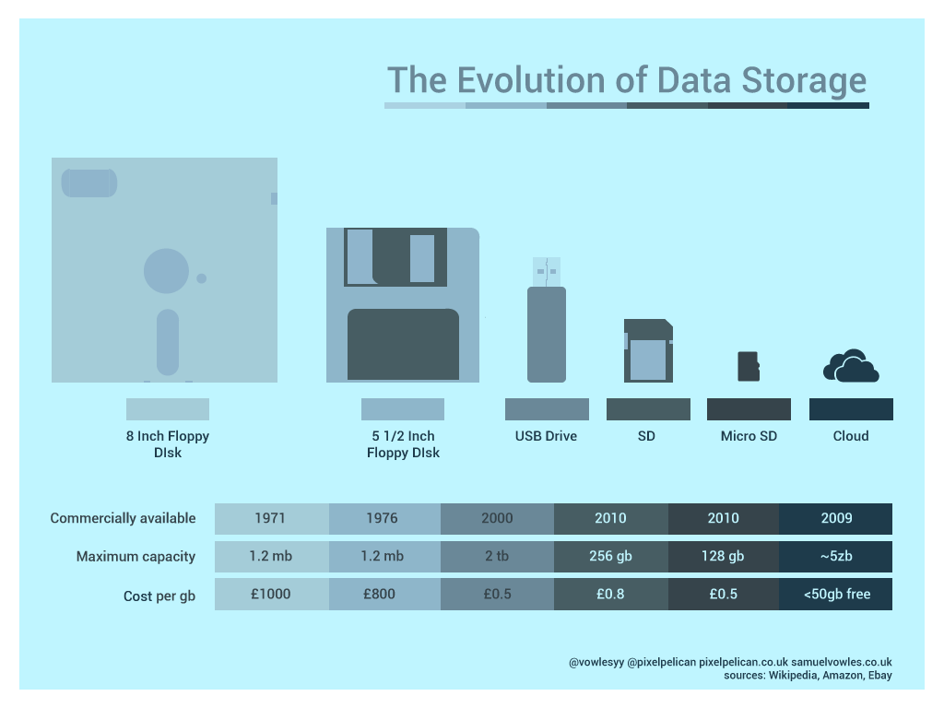

Slide 9
Big Data
Fun Facts:
Every second, Google processes over 40,000 searches or 3.5 billion a day
On a minute-by-minute basis, Snapshot users share 527,760 photos.
Every minute, there are 156 million email message sent
4.1 million videos users watch on YouTube per minute
It seems like a good bet that the volume of data will continue to increase.
Today, we want as much [data] as we can get – not only to drive better insight into business problems we’re trying to solve, but because the more data we put through the machine learning models, the better they get.

Slide 10
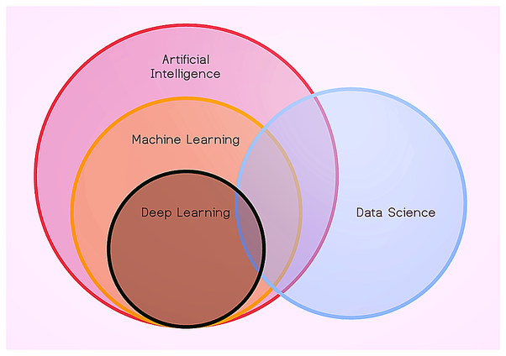
Data Science is BIG
Artificial Intelligence – work and react like humans
Machine Learning –
create tools to extract knowledge from data
Deep Learning –
use the way our brain works to perform advanced analysis

Slide 11
Activity
Be the first to win 20 games of rock-paper-scissors against the AI
http://bit.ly/iai4yrps
Notes:
Add backup questions here if no response.

Slide 12
Discussion
Did the computer figure out your gameplay?
Did playing more games allow it to perform better?
Notes:
Add backup questions here if no response.

Slide 13
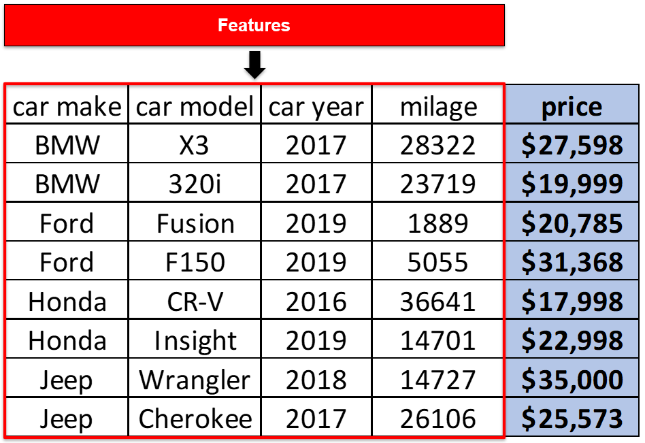
Data Characteristics
Features: properties of the data used for prediction
Correlation: how relevant the data is to the goal of the program
AI Goal: Use features to predict the price of a car

Slide 14
Data Characteristics
Low Correlation
Feature:
What other streaming services the user is subscribed to
Goal: Recommendation of a movie tailored to the user
Feature:
Previous genres watched
High Correlation

Slide 15
Data Characteristics
Frequency of Data: how quickly is the data updated?
Is high frequency of data important in predicting sales over a calendar year?
Is high frequency of data important in autonomous vehicle cameras?
No!
Yes!

Slide 16
Data Characteristics
Period of Data: how long do we need the data for our uses?
The predicted grade of a specific student in my class?
For predicted world population growth?
One Semester
Many Years

Slide 17
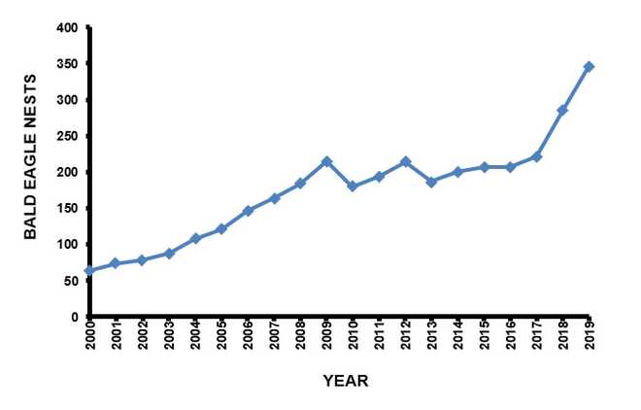
Data Characteristics
Trend of Data: what story is the data telling us about our goal?
Goal: Predict the future health of bald eagle population
Increasing trend
The population is growing

Slide 18
Activity
Separate into pre-determined groups
Notes:
Add backup questions here if no response.

Slide 19
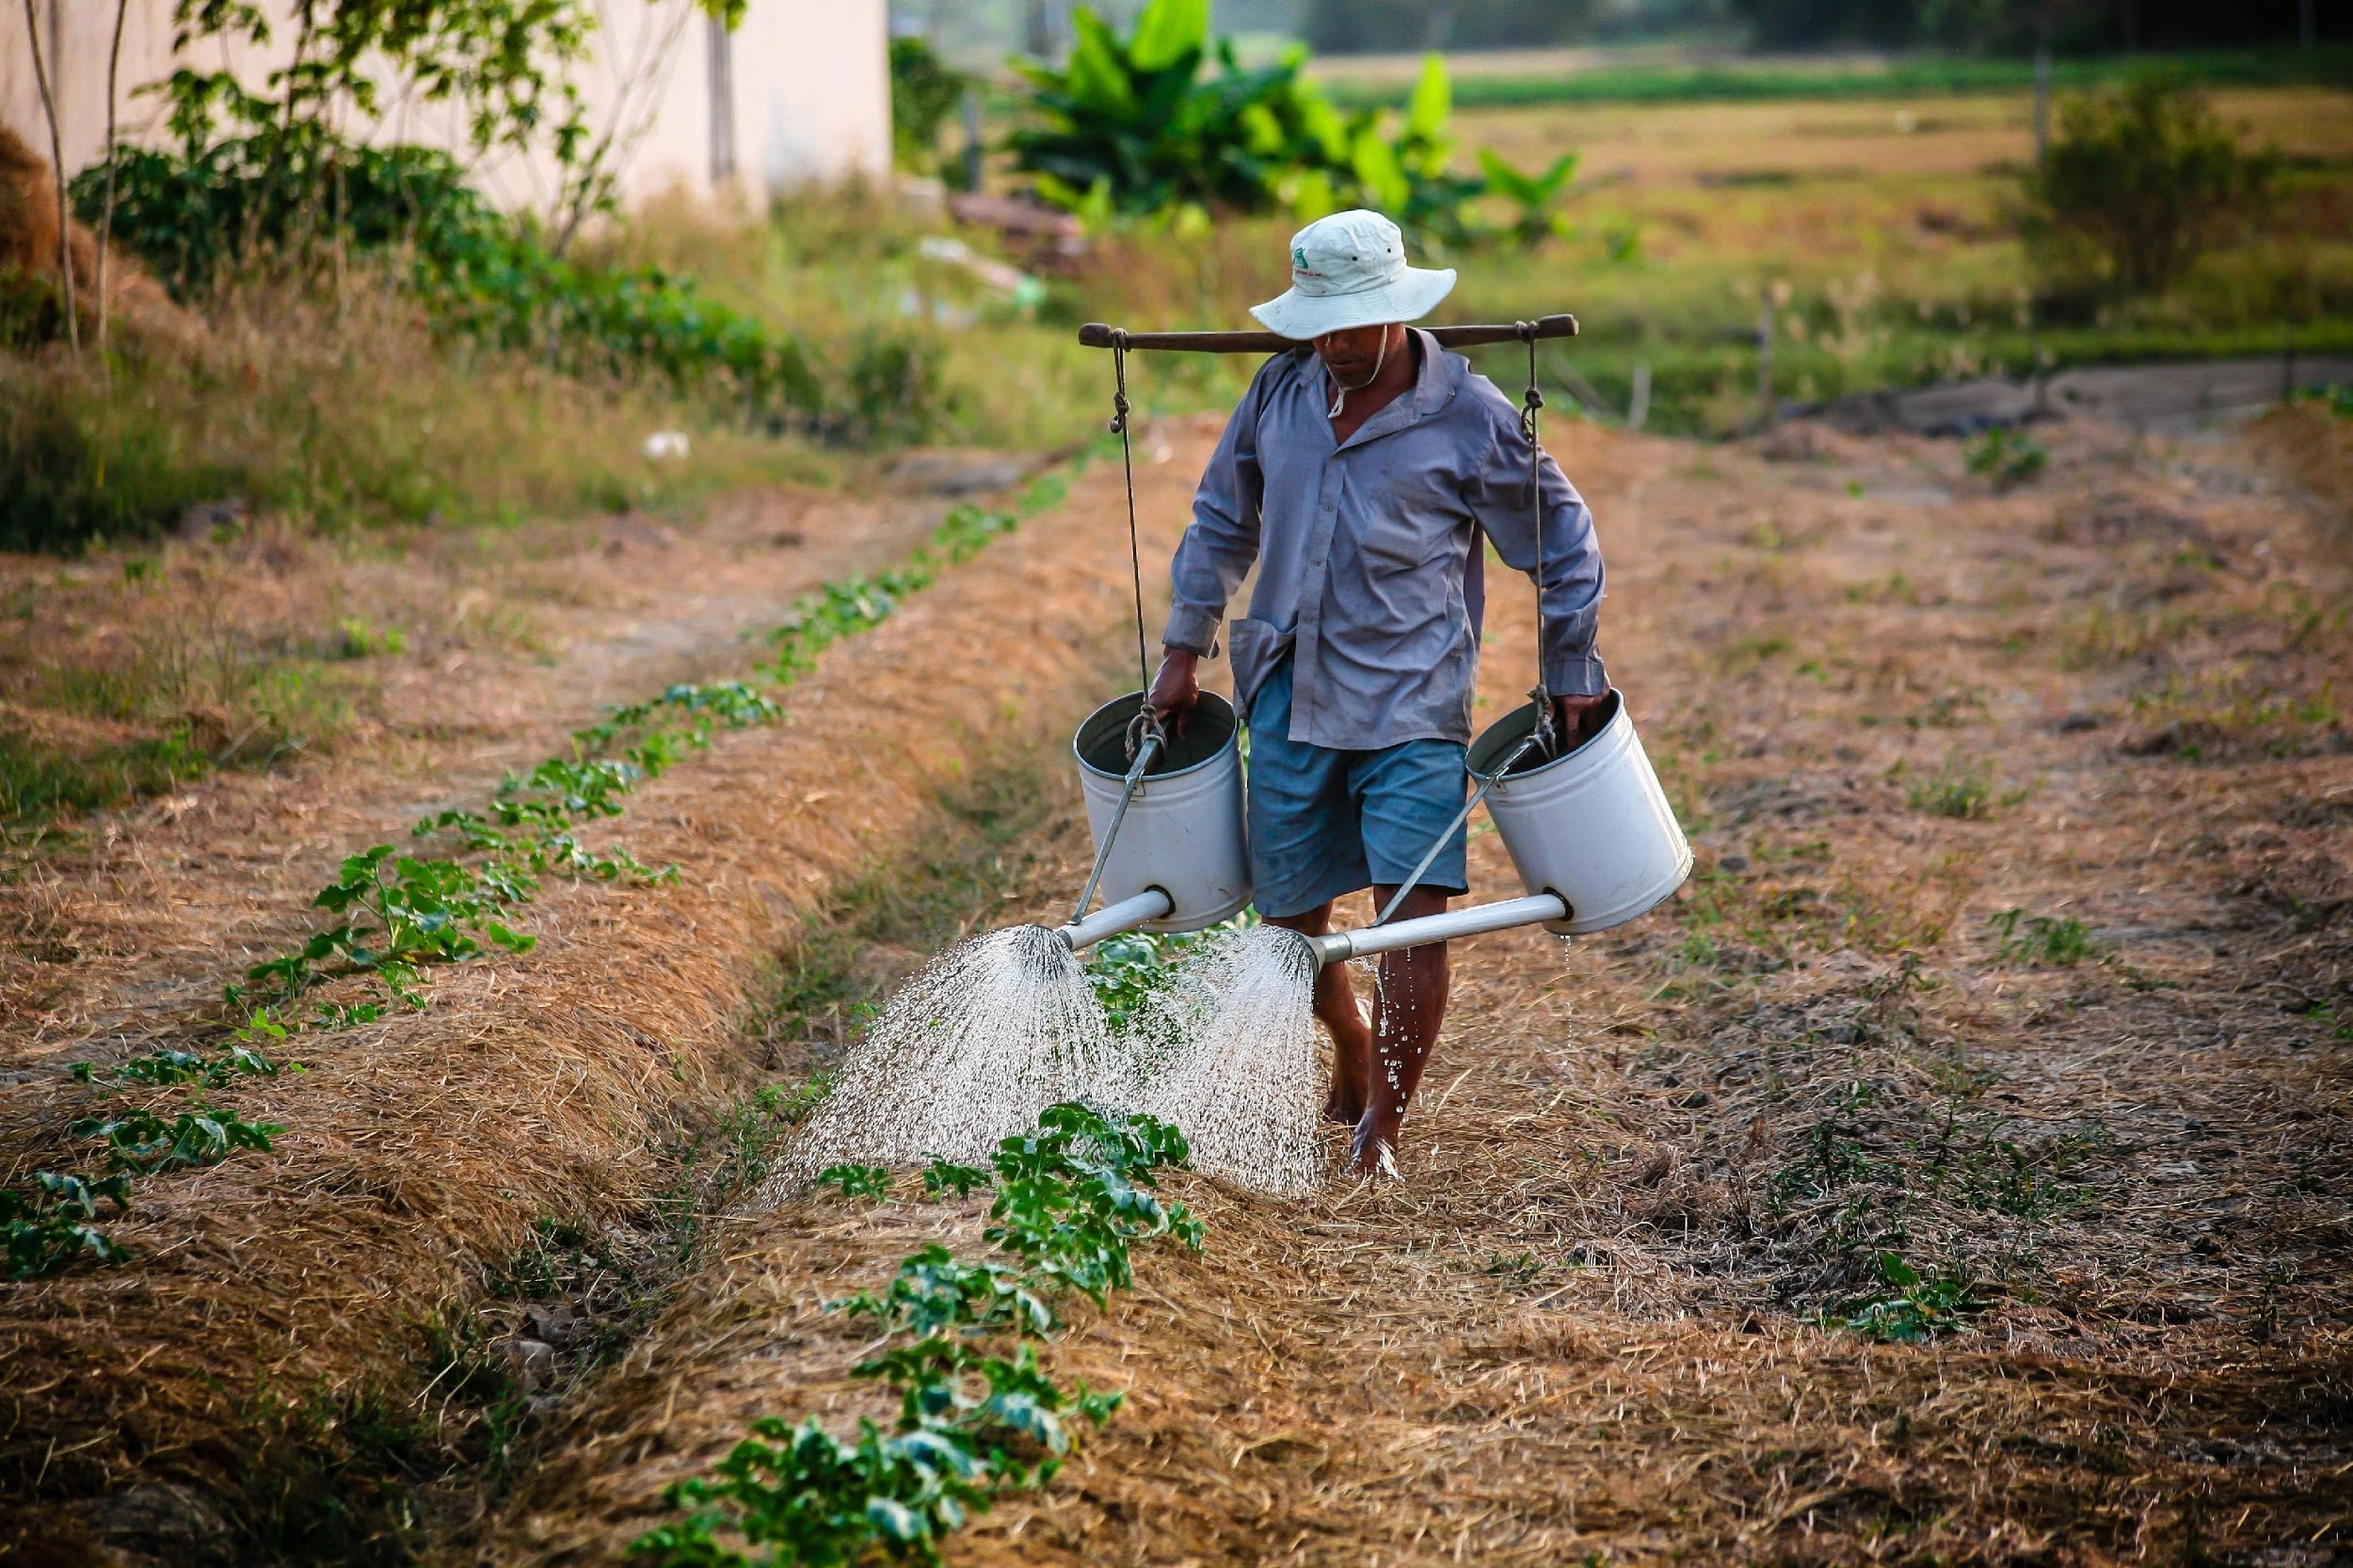
QUEST ALERT!
What highly-correlated features could we use to help farmers determine best times for seeding / sowing their crops.

Slide 20
Possible Data Features:
Rainfall
Temperature
Humidity
Price of water
Location of farm

Slide 21
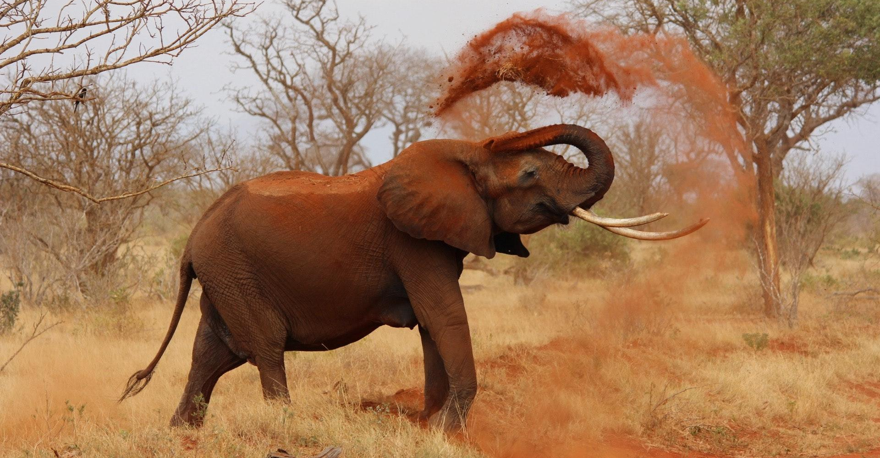
QUEST ALERT!
What highly-correlated features could we use to reduce illegal poaching of elephant tusks?

Slide 22
Possible Data Features:
Location of poachers
Location of elephants
Sales price of tusks
Information about demand of tusks

Slide 23
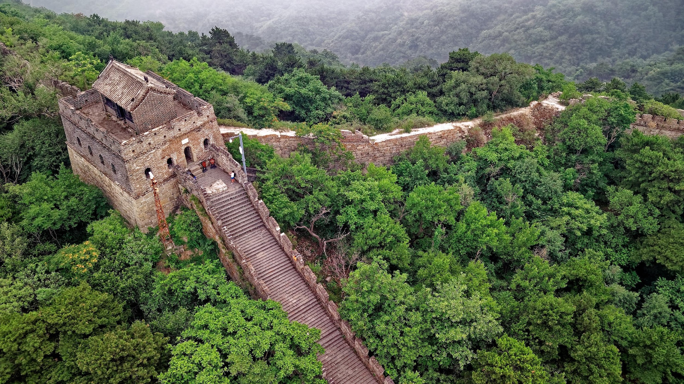
QUEST ALERT!
What highly-correlated features could we use to preserve the Great Wall of China more efficiently?

Slide 24
Possible Data Features:
Image of wall
Tourist Data
Temperature
Rainfall

Slide 25

QUEST ALERT!
What highly- correlated features could we use to predict whether a songs makes it to the billboard?

Slide 26
Possible Data Features:
Tempo of music
Current Trends
Genre of music
Duration of song

Slide 27

QUEST ALERT!
What highly- correlated features could we use to improve the exam scores of students?

Slide 28
Possible Data Features:
How far students live
How do students spend their time
Hobbies of students
How much time they spend in school
How enjoyable they find a lesson

Slide 29

Data Exploration
“Exploring data” - Gives us a sense of trends/patterns between other sets of data
When choosing a book, you look at the front cover / back cover, table of contents and you may skim through. Building an idea of what it’s use will be to you.

Slide 30
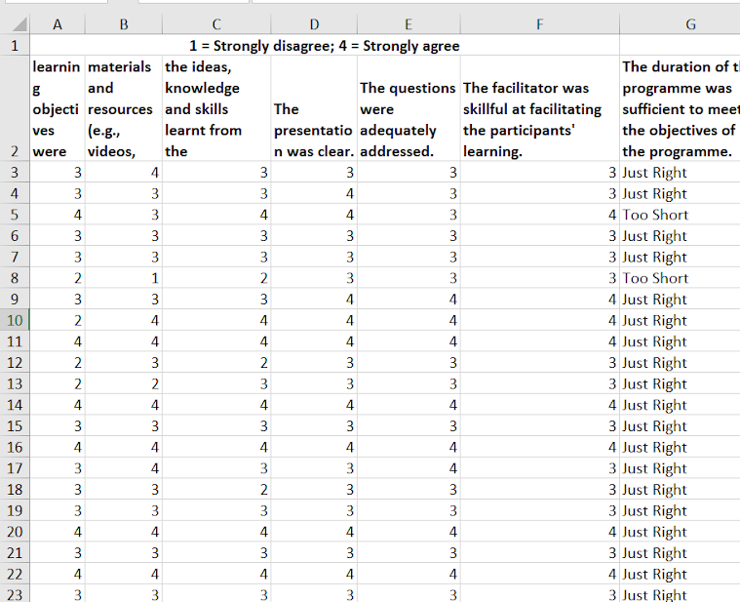
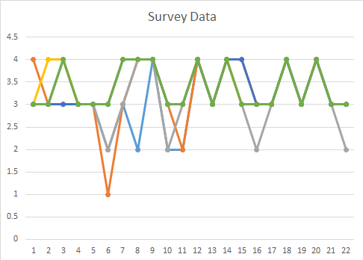
Visualization – Data Exploration
Visualization makes it easier to understand and communicate with others

Slide 31
Data Visualization Activity
Split into your usual groups
Go to datavizcatalogue.com
Choose two graphs suited for the goal and data features we discussed.
Need data resources?:
https://wiki.dbpedia.org/ https://data.gov.in/
https://data.gov.uk/ https://www.data.gov/

Slide 32
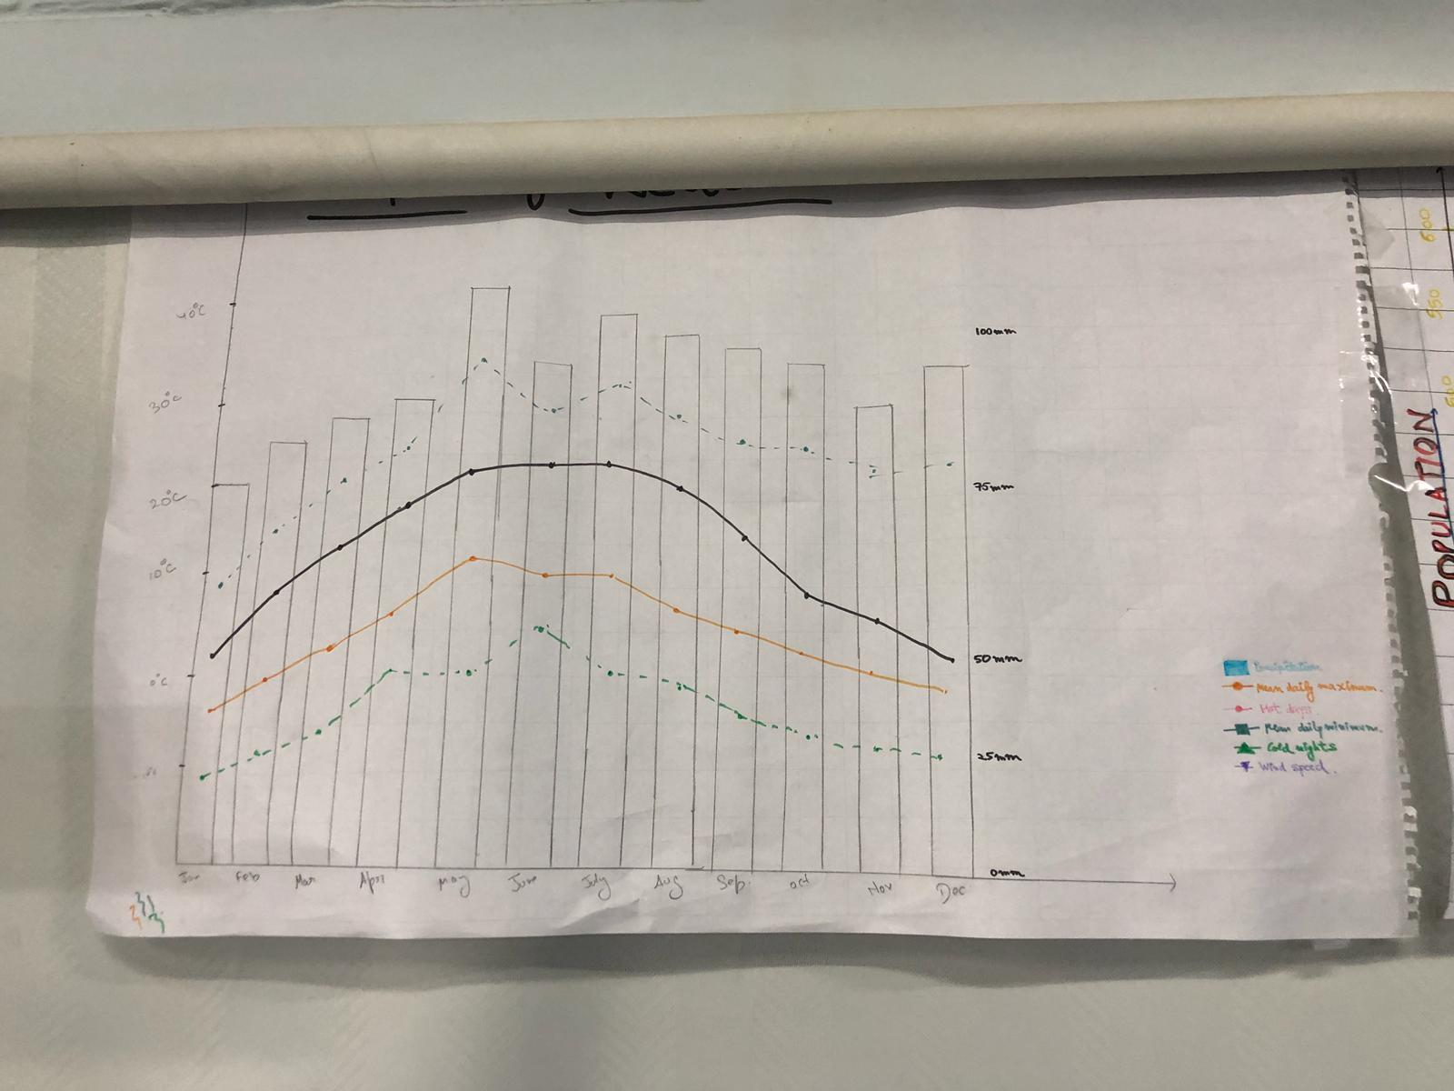
Samples of previous students work

Slide 33
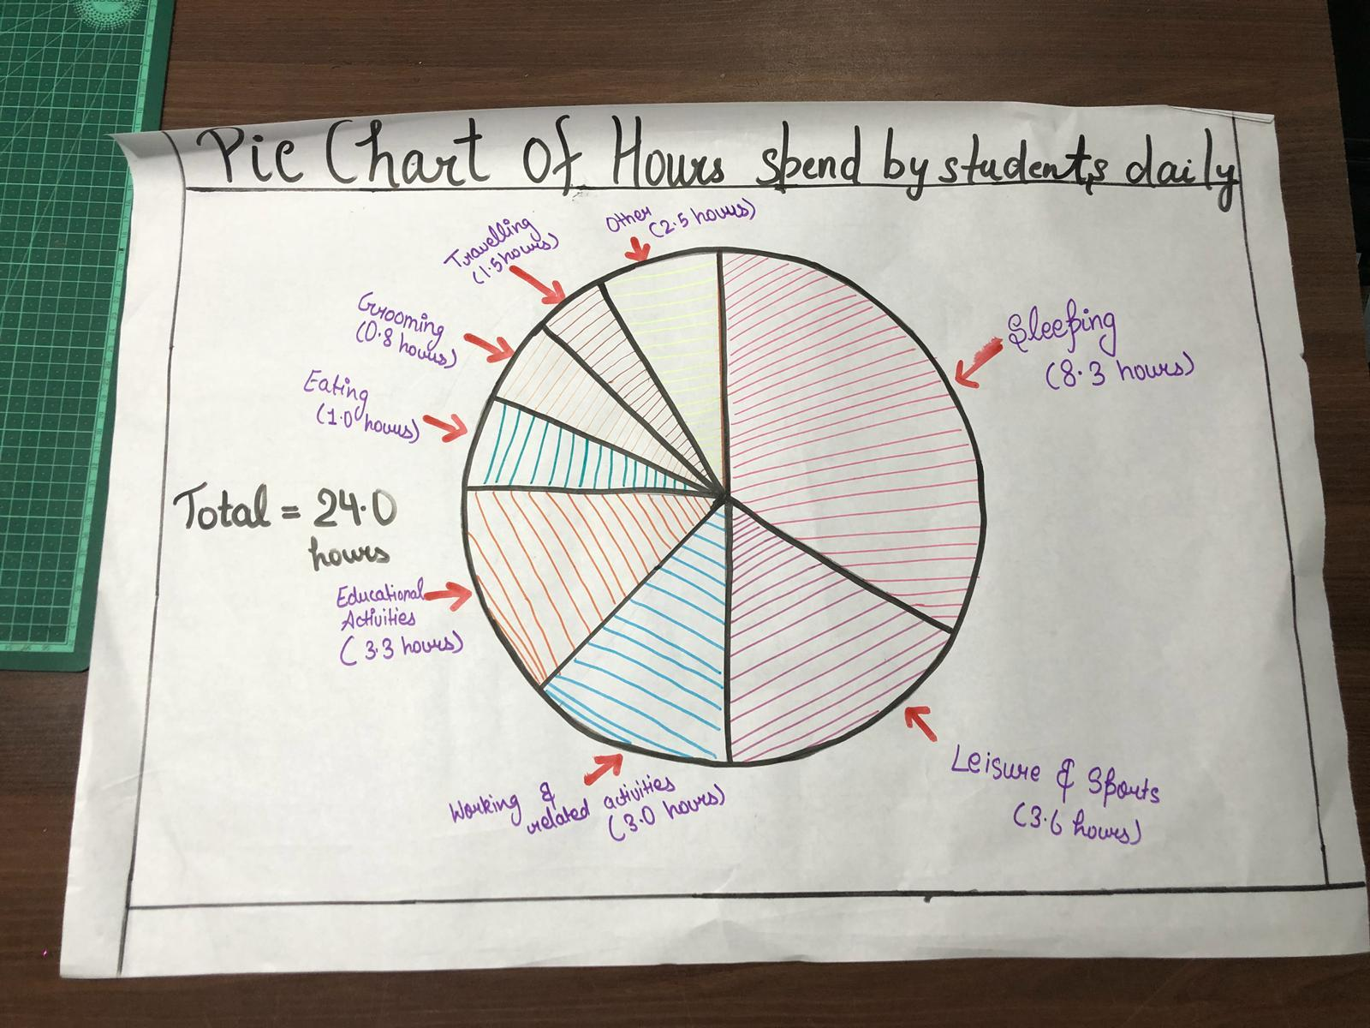
Samples of previous students work

Slide 34
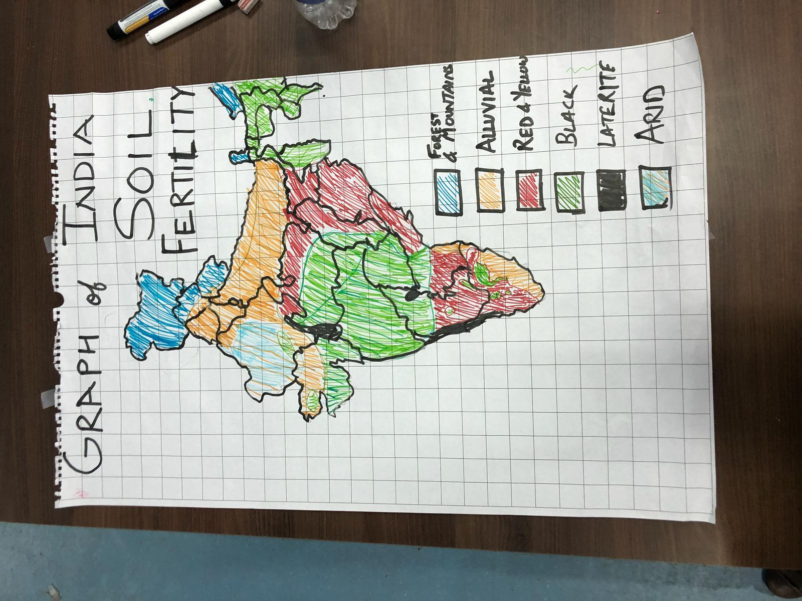
Samples of previous students work

Slide 35
Summary
Structured data is labeled and formatted
Unstructured data is information that has no predefined formatting
Big data describes a way to handle huge amount of volumes of information
Quantity of data is certainly important, but there are also needs to be much work on the quality. Even small errors can have a huge impact on the results of an AI model.

Slide 36
Extra Slides

Slide 37
Activity
Be the first to win 20 games of rock-paper-scissors against the AI
http://bit.ly/iai4yrps
Notes:
Add backup questions here if no response.

Slide 38
Discussion
Did the computer find trends in your gameplay?
Did playing more games allow it to perform better?
Notes:
Add backup questions here if no response.

